Slide 1

Evaluation of Machine Learning Algorithms for the Detection of Fake Bank Currency
Abstract
Malpractising has always been a serious challenge that resulted in a serious problem in society . The automation in technology creates a more copied currency that is entirely spread , resulting in reducing the economic growth of the country .
Counterfeiting of bank currency is a significant and persistent problem that threatens financial institutions and economies.
It discusses the use of machine learning algorithms to detect fake bank notes as an evolving and effective solution to combat counterfeit currency.
Presented By:
Sai Teja 20W91A1212
Dilip Kumar 20W91A1218
Akhil 20W91A1209
Satish 20W91A1238
Varshini 20W91A1255
Supervisor:
Mrs.K.Malar
Project coordinator:
Mr.N .Chandraprakash

Slide 2
Introduction
Despite a decrease in the use of currency due to the recent growth in the use of electronic transactions, cash transactions remain very important in the global market.
Banknotes are used to carry out financial activities.
Machine learning techniques help in building applications that support in detection of currency , through automated system and algorithm.
Machine learning is going to use pattern recognistion and image processing for analyzing the real characteristics.
Bank currency authentication can be detected using six supervised machine learning algorithms that were tested on a dataset from the UCI machine learning repository.

Slide 3
Literature Review
Proposed System detects the fake bank currency using machine learning algorithms.
The proposed system is also scalable for detecting the whether the currency is fake or not by image processing.
Proposed System gives genuine and fast result than existing system .
Here in this system we use CNN algorithm to detect whether currency is fake or not.

Slide 4
Methodology
CNN Algorithm
Convolutional Neural Network is one of the main categories to do image classification and image recognition in neural networks.
CNN’s output is further analysed using machine learning algorithms to improve its accuracy and efficiency.

Slide 5
Random Forest
It is used for classification and regression tasks due to high accuracy , robustness.
Logistic Regression
It is used to predict the probability of a binary outcome such as yes or no ,true or false,0 or 1.
Naive Bayes
which is used for classifications tasks , like text classification.
It is simple and easy to implement . It doesn’t require as much training data . It handles both continuous and discrete data.

Slide 6
Decision Tree
which is utilised for classification and regression tasks.
It has hierarchical , tree structure, which consists of a root node, branches, internal nodes and leaf nodes.
Support vector machine
SVM is a supervised learning algorithm used in machine learning to solve classification and regression tasks.
SVM’s are particularly good at solving binary classification problems.
K-Nearest Neighbors (KNN)
KNN is a non parametric ,supervised learning classifier, which uses proximity to make classifications or prediction about the grouping of an individual data point.

Slide 7
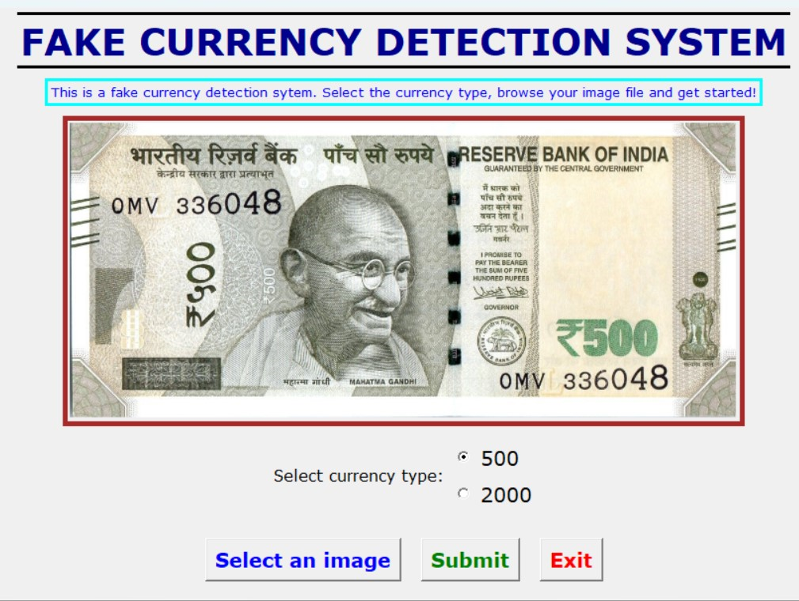
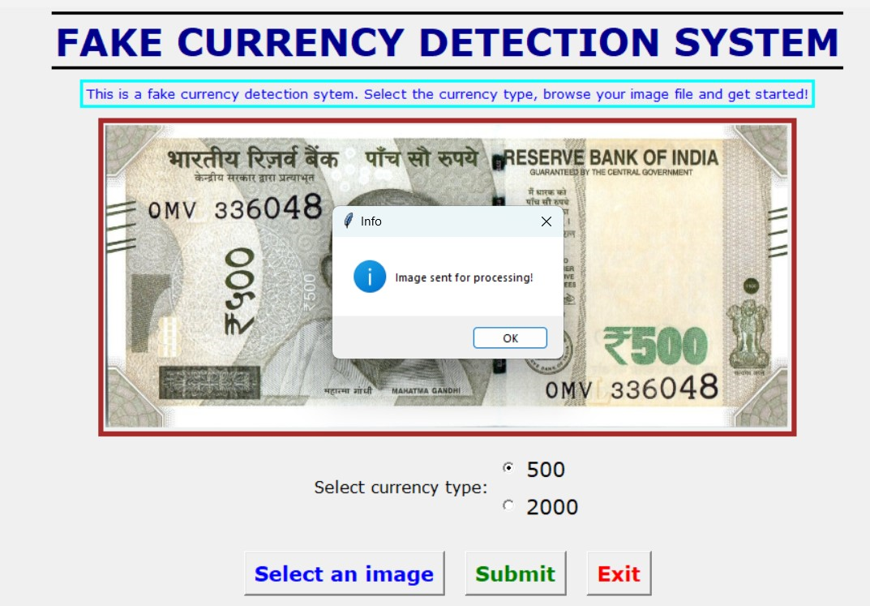
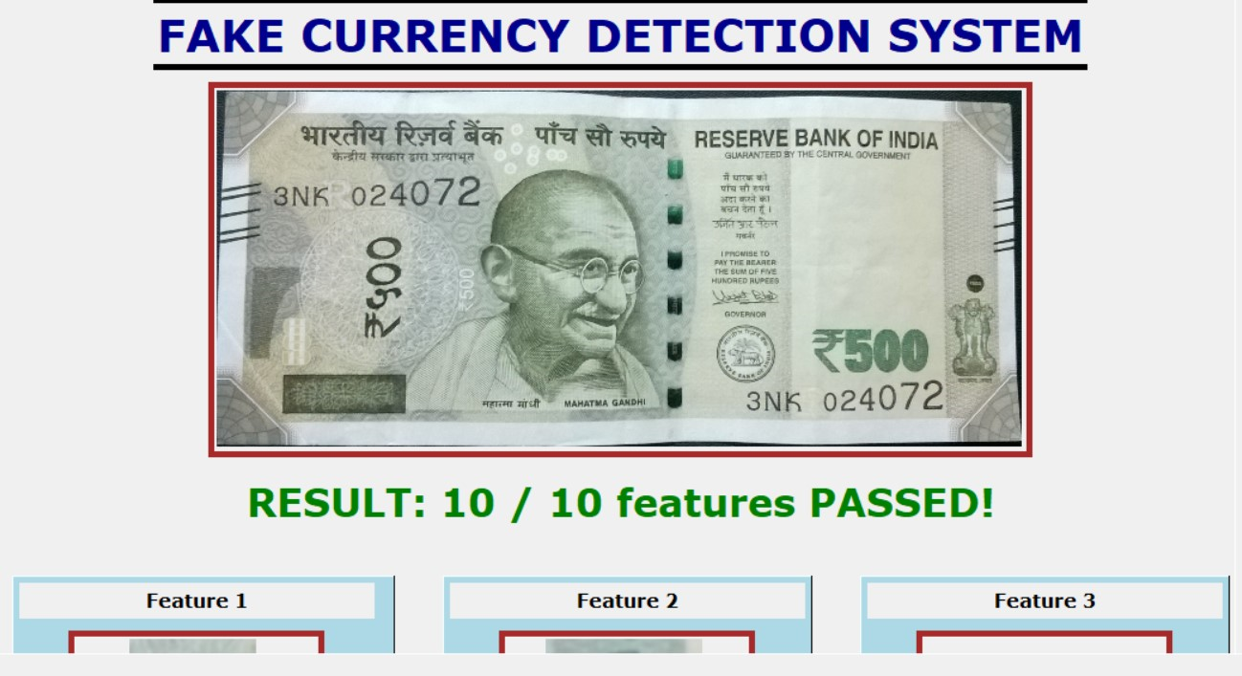
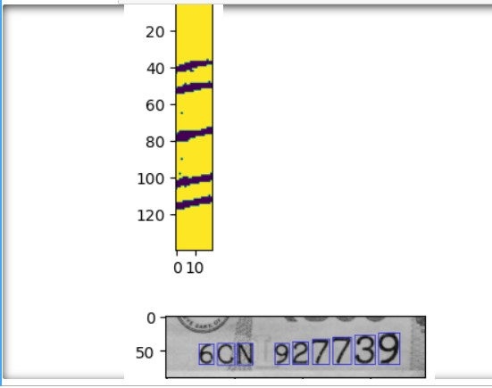
Result:
Fig.1:Here we have to choose image.
Fig.2:Here image is sent for processing.
Fig.1
Fig.2
Fig.3:Here it will show the parameters.
Fig.4:Here its shows whether the currency is fake or not.
Fig.4
Fig.3

Slide 8
Conclusion
The project “Fake currency detection using machine learning “provides an in-depth analysis of the proposed approach for detecting counterfeit notes.
Computer programs called machine learning algorithms has been very helpful in detecting fake money . These algorithms have gotten better over time , making it easier to catch counterfeit currency.
To keep protecting our money , it’s essential to keep improving these algorithms as counterfeiters also keep getting smarter.

Slide 9
Acknowledgments
First and foremost, we are grateful to the Principal Dr. P. SRINIVAS, for providing us with all the resources in the college to make our project a success. We thank him for his valuable suggestions at the time of reviews which encouraged us to give our best in the project.
We would like to express our gratitude to Mr. V. RAMAKRISHNAN, Head of the Department, Department of Information Technology for his support and valuable suggestions during the dissertation work.
We offer our sincere gratitude to our project - coordinator Mr. N. CHANDRA PRAKASH, for his support and valuable suggestions during the dissertation work.
We offer our sincere gratitude to an internal guide Mrs. K. MALAR, Professor of the department of Information Technology who has supported us throughout this project with patience by offering valuable suggestions.
We would also like to thank all the supporting staff of the Department of Information Technology and all other departments who have been helpful directly or indirectly in making the project a success.
.

Slide 10
References
1. Vidhate, Y. Shah, R. Biyani, H. Keshri, R. Nikhare, Fake currency detection application. Int. Res. J. Eng. Technol. (IRJET) 08(05) (2021). e-ISSN: 2395-0056.
2. A.A. Mandankandy, K.E. Kannammal, Fake currency detection: a survey. Gedrag en Organisatie 33(4), 622–638 (2020).
3. A.A. Mandankandy, K.E. Kannammal, Fake currency detection: a survey. Gedrag en Organisatie 33(4), 622–638 (2020).
4. A.Singh, K. Bhoyar, A. Pandey, P. Mankani, A. Tekriwal, Detection of fake currency using image processing. Int. J. Eng. Res. Technol. (IJERT) 8(12) (2019).
5. G. Navya Krishna, G. Sai Pooja, B. Naga Sri Ram, V. Yamini Radha, P. Rajarajeswari, Recognition of fake currency note using convolutional neural networks. Int. J. Innov. Technol. Exploring Eng. 8(5), 58–63 (2019).

